Slide 1
Detecting Spam Web Pages through Content Analysis
Alexandros Ntoulas
Mark Manasse
Marc Najork
Dennis Fetterly

Slide 2
Spam Web Pages
Unethical method of Search Engine Optimization
Dummy pages that provide no useful content
Pages with the sole purpose of increasing the ranking of other affiliated pages
Other methods focus solely in page links, this technique focuses on page content

Slide 3
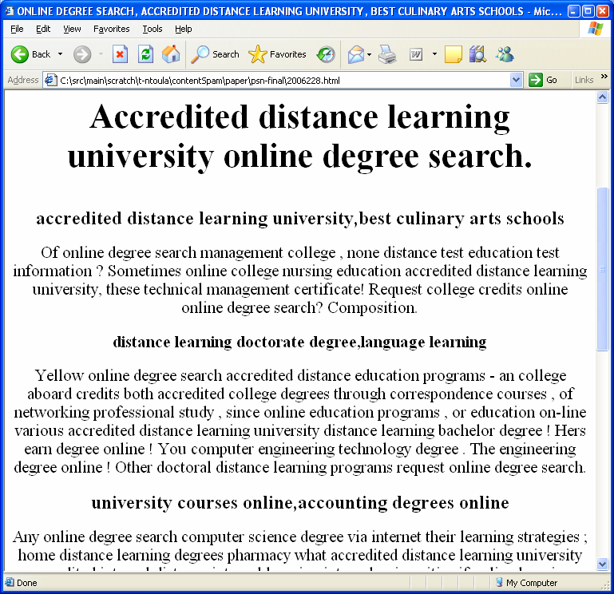
Spam Web Pages

Slide 4
How the Data was Obtained
MSN Search Crawl
Not uniformly at random
Already some spam filtering
Still valid because
Approximate data seen by users
Higher trafficked/well connect pages which are usually ranked higher by search engines

Slide 5
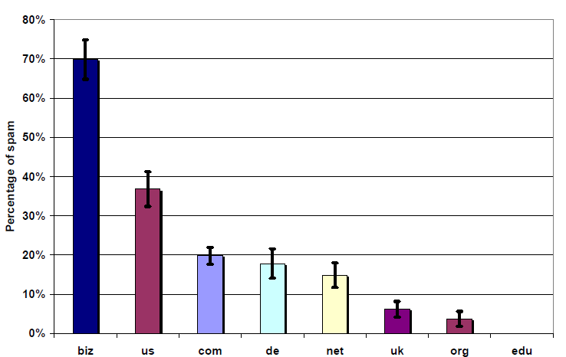
Spam per top-level domain

Slide 6
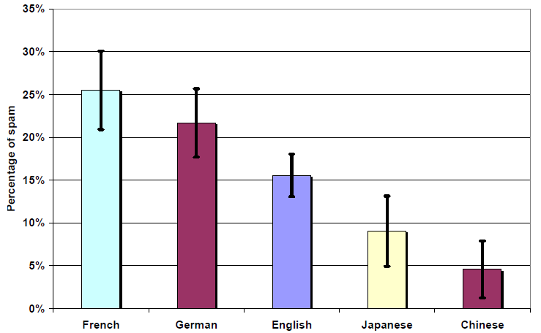
Spam per Language

Slide 7
The Data
Uniform Random Sample from the English portion of the 105 million pages
17,168 pages were manually classified
2,365 pages were spam (13.8%)
14,803 pages were non-spam (86.2%)
Results generally hold for other languages as well

Slide 8
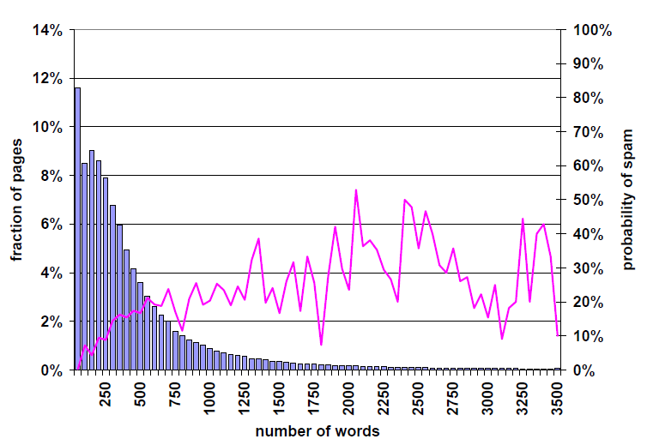
Number of Words

Slide 9
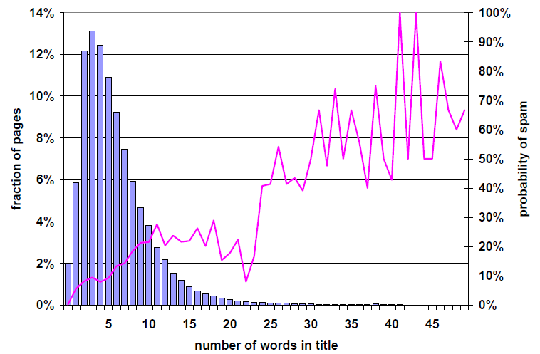
Number of Words in Title

Slide 10
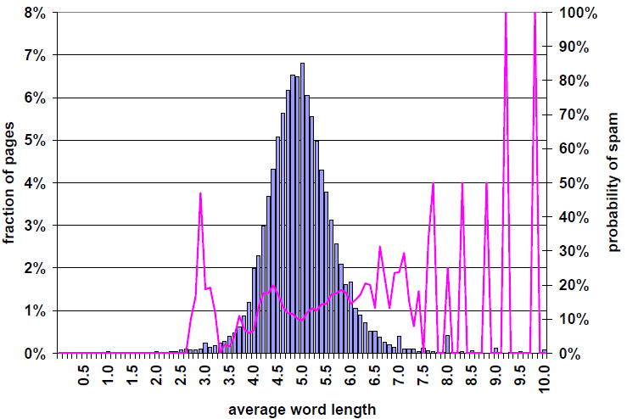
Average Word Length

Slide 11
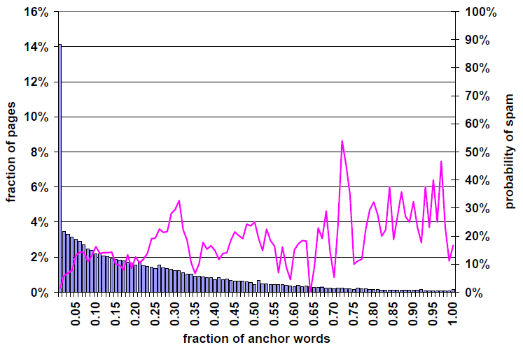
Fraction of Anchor Words

Slide 12
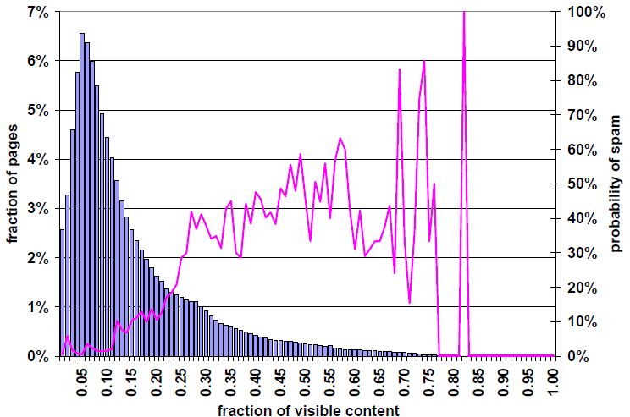
Fraction of Visible Content

Slide 13
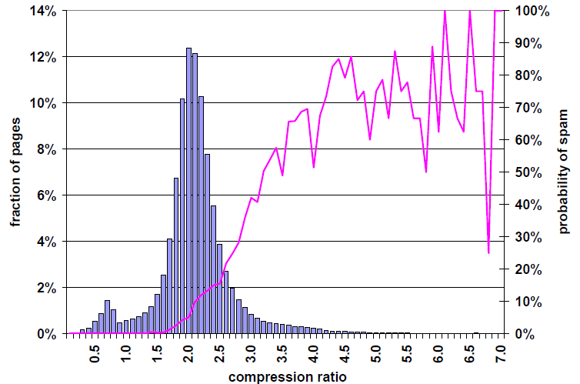
Compression Ratio

Slide 14
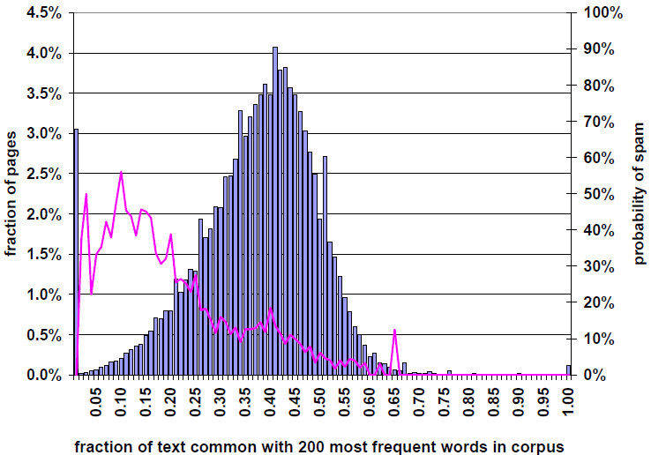
Fraction of Text that is the 200 Most Common Words

Slide 15
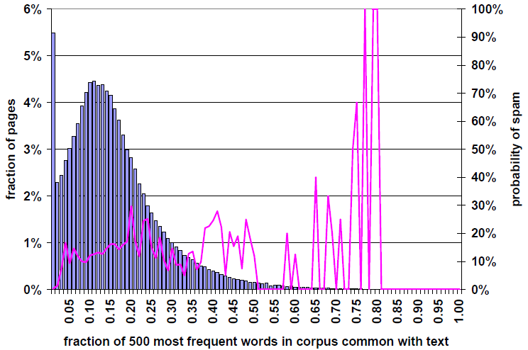
Fraction of 200 Most Common Words Contained in the Page

Slide 16
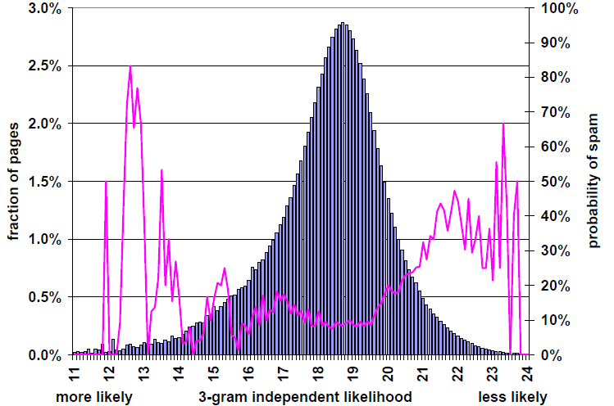
Independent n-gram Likelihoods

Slide 17
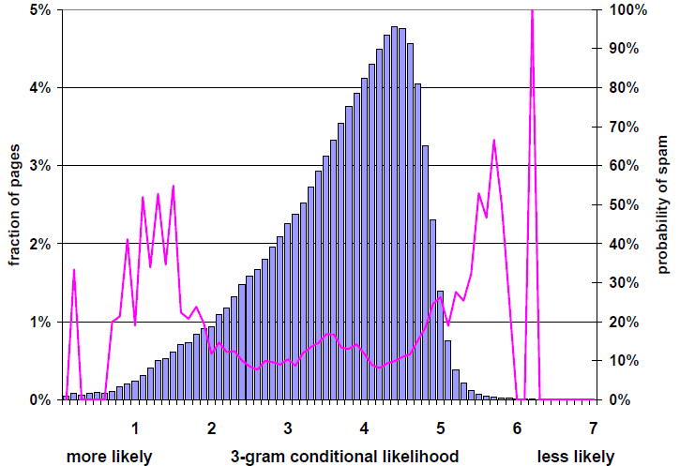
Conditional n-gram Likelihoods

Slide 18
Using these Results
This analysis gives a set of attributes for each spam and non-spam page
The researchers used a C4.5 decision tree classifier
Gain/ratio metric

Slide 19
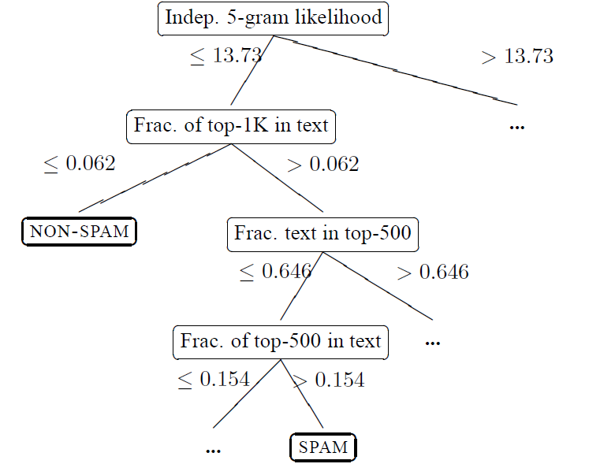
Decision Tree

Slide 20
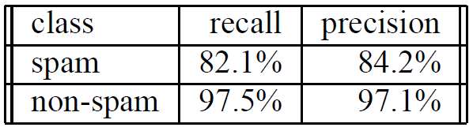
Testing the Decision Tree
Using 10-Fold Validation

Slide 21
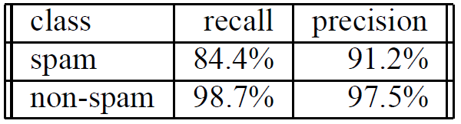
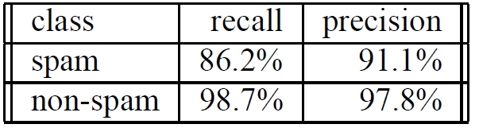
Improving Accuracy
Bagging
Boosting

Slide 22
Issues with Technique
Some individual classifiers presented in the paper could be easily fooled
Difficult to circumvent them all
Effectiveness may still decrease with time

Slide 23
Future Work
Incorporate natural language techniques to recognize artificially generated text
Combine this approach in a multilayered spam-detection system

